Slide 1
Github Repository Setup
Once I do invite you to the github repository you will receive an email to accept as a collaborator
Once you accepted it you could able to see the repository and clone it for further operation
Please check whether you have an access to pull and push code to the branch

Slide 2
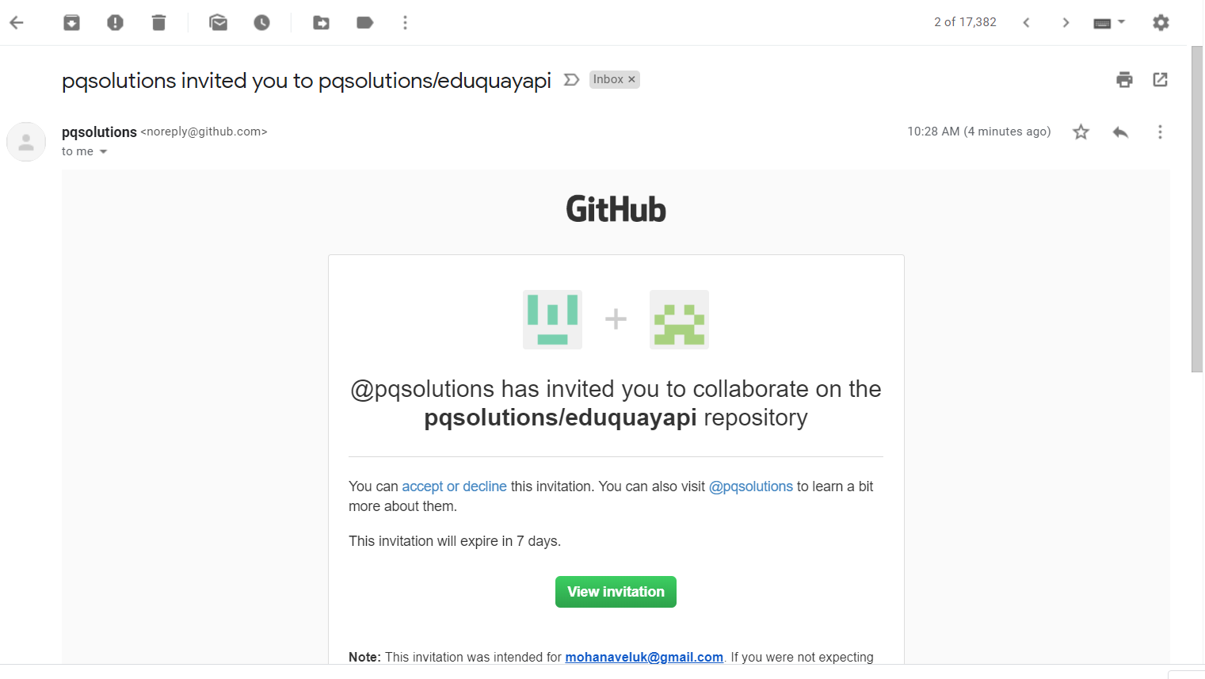

Slide 3
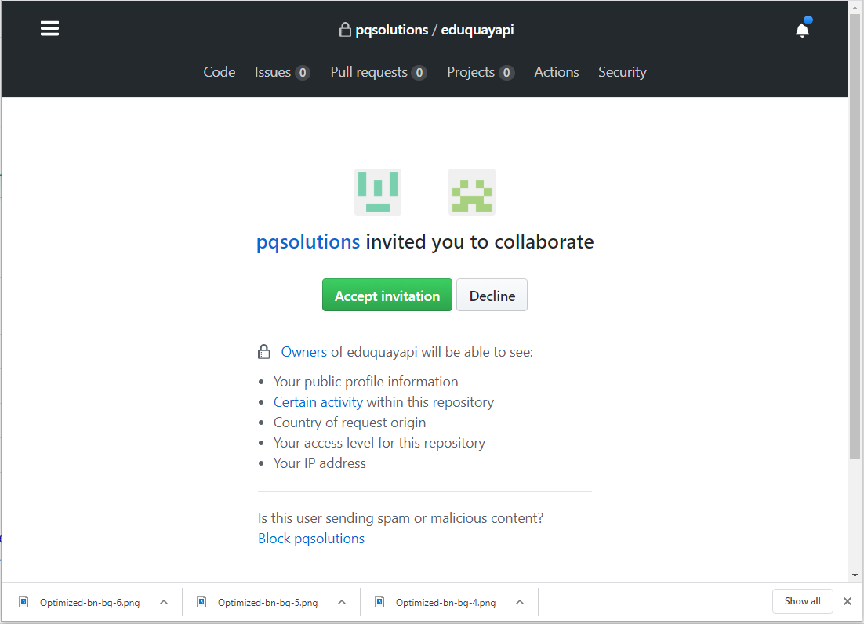

Slide 4
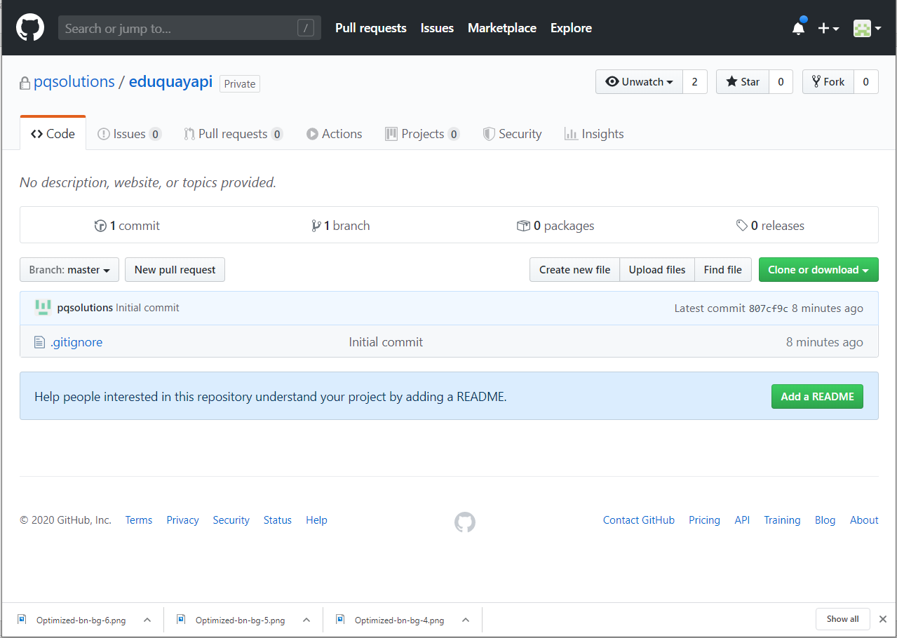

Slide 5
